Slide 1
Computer Vision: Portfolio 2
A Portfolio Presentation of Assignments in Explainable and Edge Al
Prahas Hegde, Rohan Sanjay Patil, Vidya Padmanabha
Lecturer: Prof. Dr. Dominik Seuß

Slide 2

Tackling Two Critical Frontiers in Applied Al
Part I: Explainable Al in Medicine
Part II: Edge Al for Industry 4.0
The Challenge of Trust
How can we make life-or-death decisions from a medical Al transparent and trustworthy for clinicians?
The Challenge of Speed
How do we make Al fast, reliable, and small enough to perform quality control on a high-speed factory floor?

Slide 3
ASSIGNMENT 1
Explainable AI for Medical Imaging - Interpreting Chest X Ray Pneumonia Predictions

Slide 4
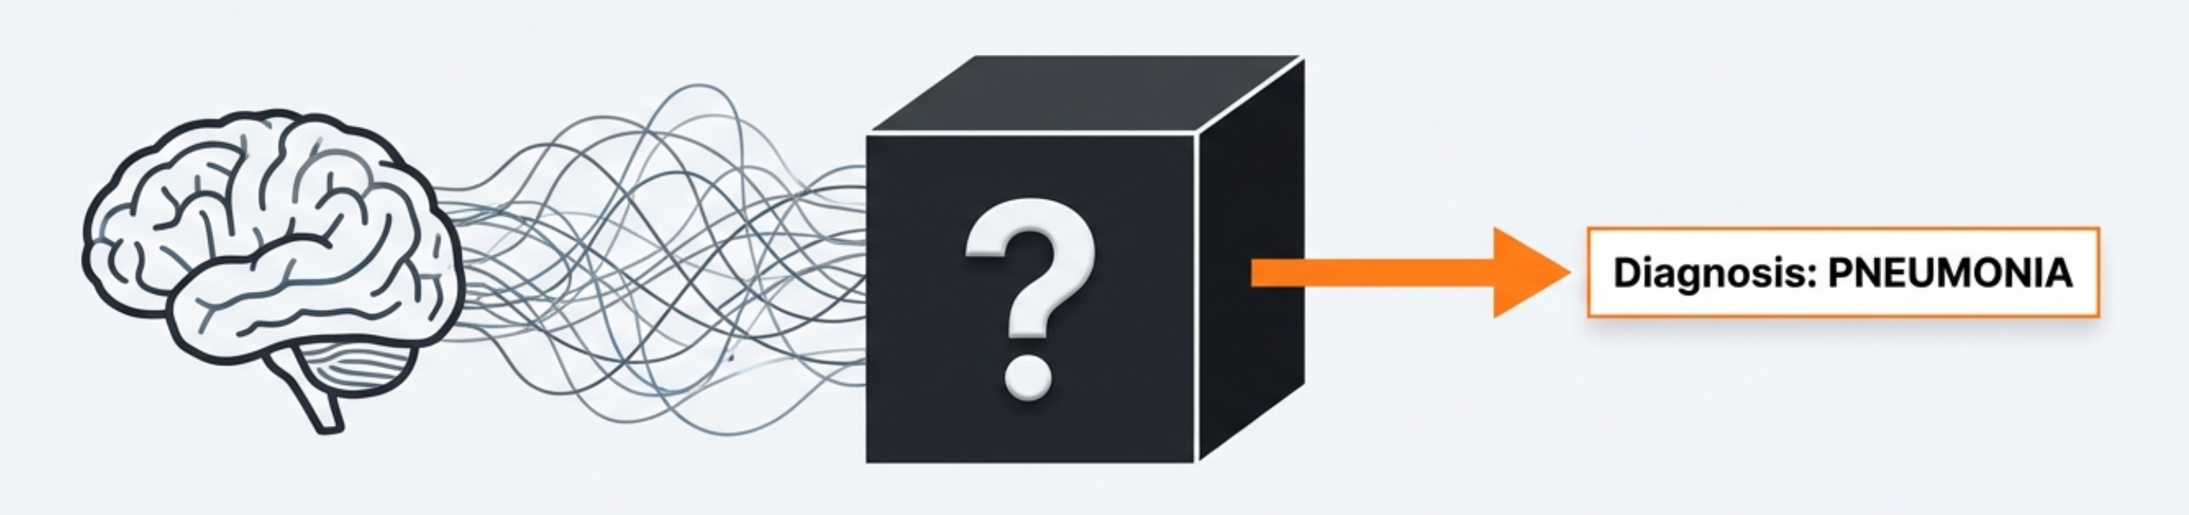



The ‘Black Box’ in Medical Al is a Critical Barrier to Trust
High Performance: Deep learning models can diagnose diseases with high accuracy.
Lack of Transparency: Their decision-making process is often opaque, making it difficult to understand *why* a prediction was made.
The Trust Gap: This opacity creates a barrier to adoption where accountability and understanding are essential.

Slide 5
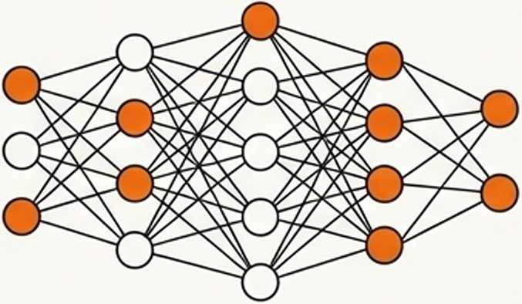

Our Objective: To Build and Interpret a Pneumonia Classifier
To design an end-to-end explainability pipeline that can not only detect pneumonia but also provide clear, visual justifications for its predictions.
1. Prediction
2. Explanation
Fine-tune a high-performance ResNet50 model to classify chest X-rays as ‘Normal’ or ‘Pneumonia’.
Integrate and compare two distinct XAI methods to unlock the model's decision making process: Grad-CAM and LIME.

Slide 6
Our ResNet50 Model Achieves 87% Diagnostic Accuracy
Confusion Matrix - Test Set
172 | 62
22 | 368
Overall Test Accuracy: 87%
Precision (Pneumonia): 86%
Recall (Pneumonia): 94%
The model demonstrates strong performance, particularly in correctly identifying pneumonia cases (high recall), making its decisions worthy of explanation.
NORMAL
True Label
PNEUMONIA
NORMAL PNEUMONIA
Predicted Label

Slide 7
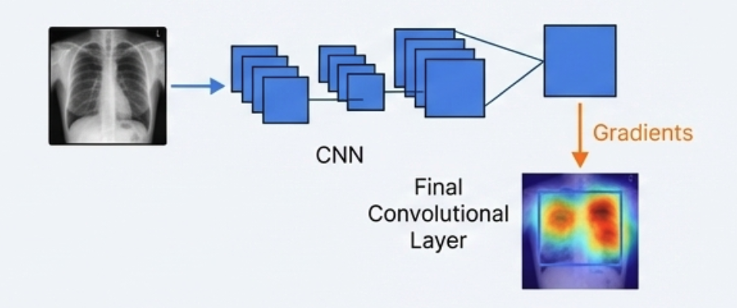
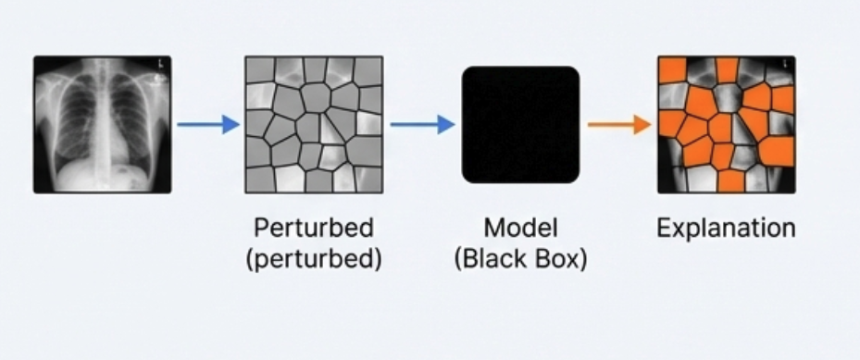
Two Methods Provide Different Windows into the Model’s Logic
Grad-CAM
LIME
"What did the model see?"
"Why did it make this choice?"
X-ray
Concept: Uses the model’s internal gradients to create a heatmap, highlighting the pixels most important for a decision.
Analogy: Like a “neural attention map.”
Type: White-box (requires access to model internals).
Concept: Treats the model as a black box. It perturbs the image and learns a simple, local model to explain which regions influenced the prediction.
Analogy: Like asking “what if this part was missing?"
Type: Black-box (model-agnostic).

Slide 8
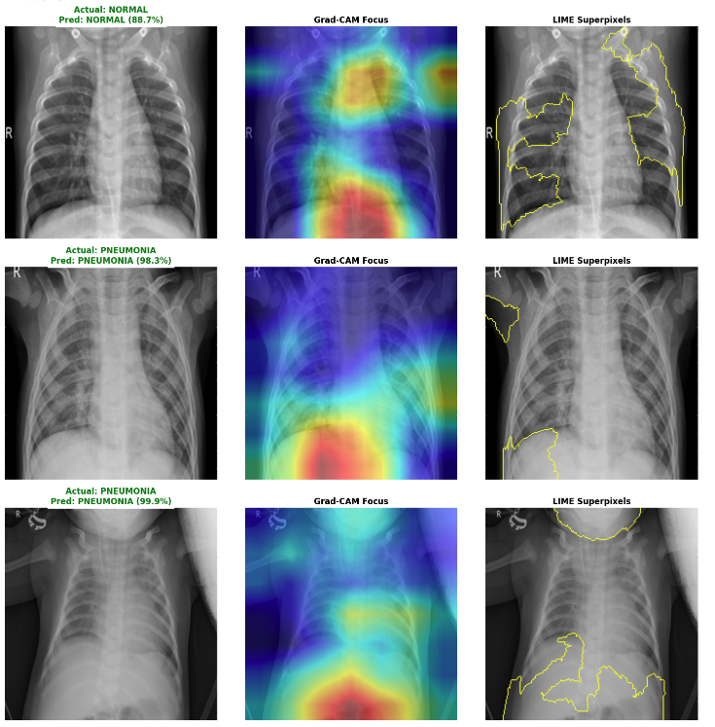
Visual Explanations Reveal Both Agreement and Divergence

Slide 9
Grad-CAM Excels in Consistency, While LIME Offers Simpler Interpretation
FEATURE | GRAD-CAM | LIME
Resolution | Pixel-level (High) | Superpixel-level (Medium)
Interpretation | Shows Gradient Importance | Shows Feature Importance
Speed | Fast | Slower
Consistency | 9/10 | 5/10
Agreement : Both methods focus on the correct lung field and areas with visible opacity when it is classified as Pneumonia.
Key Differences: Grad-CAM Provides precise, reproducible heat maps. LIME provides intuitive but less stable region-based explanations.

Slide 10
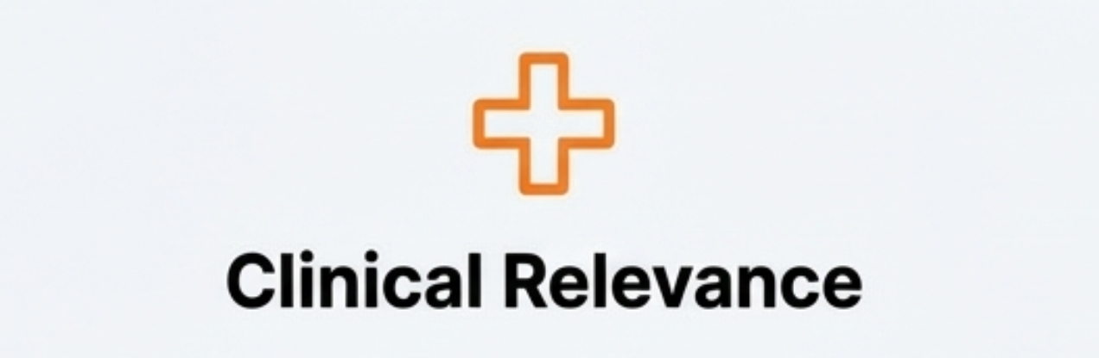
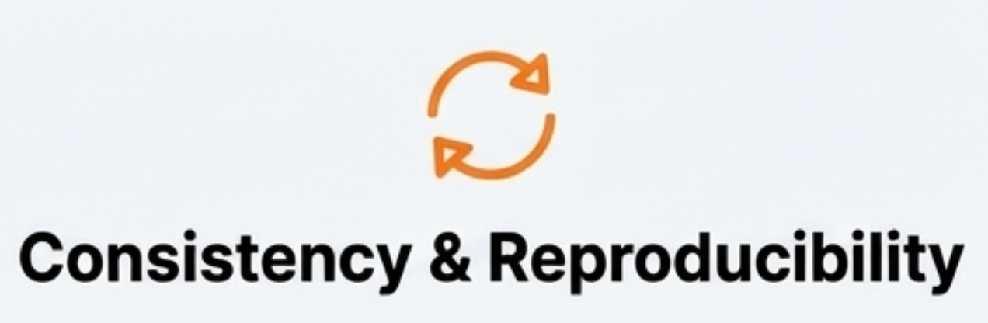
We Developed Two Criteria to Evaluate Explanation Quality
What makes an explanation 'good' in a clinical context?
Definition: Does the explanation highlight anatomically and pathologically meaningful regions?
Assesses: Focus on lung parenchyma, avoidance of artifacts (e.g., labels, bones), and correlation with visible opacities.
Definition: How stable and reliable is the explanation? Does it produce the same result every time for the same input?
Assesses: The deterministic vs. stochastic nature of the method Critical for reliable comparison and trust.

Slide 11
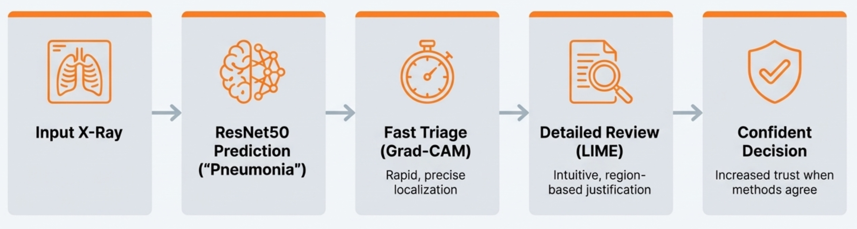
Recommendation: A Combined Approach to Build Clinical Trust
For a robust and trustworthy diagnostic system, we recommend a dual-analysis approach.
By combining the speed and precision of Grad-CAM with the intuitive clarity of LIME, we can create more transparent, reliable, and ultimately more trustworthy medical Al.

Slide 12
ASSIGNMENT 2
Edge AI for Industry 4.0 - Optimizing Models for On Device Inference

Slide 13
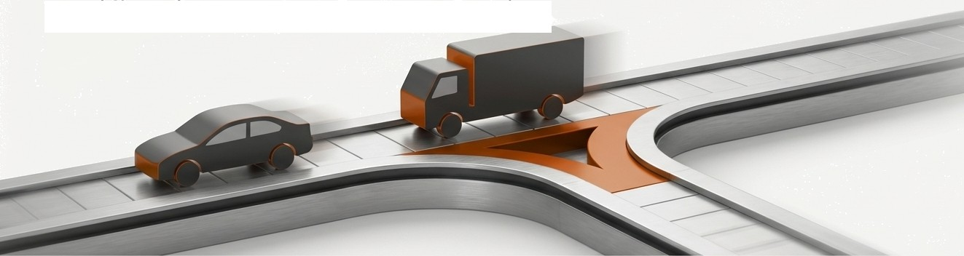
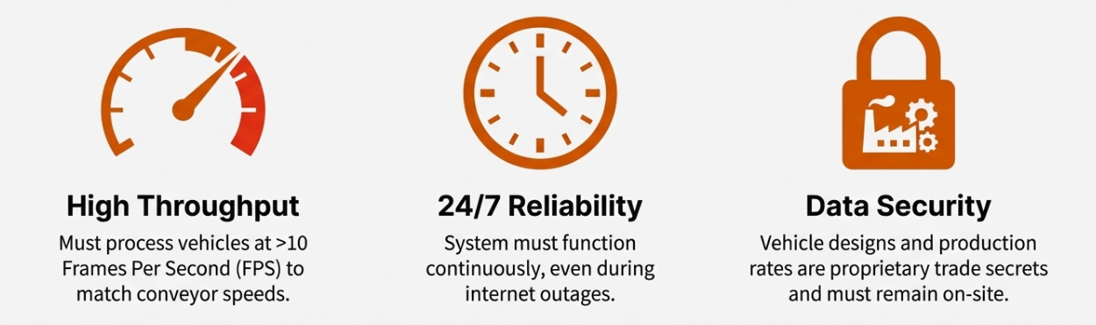
Use Case Scenario: Automated Assembly Line Vehicle Verification
An automotive assembly plant produces mixed models (Cars and Transport Trucks) on a single final assembly line. Vehicles must be instantly identified and routed to the correct finishing bay.

Slide 14
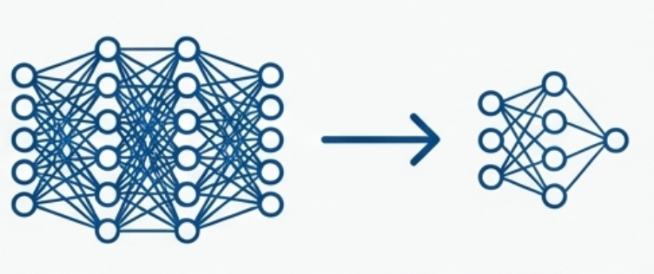
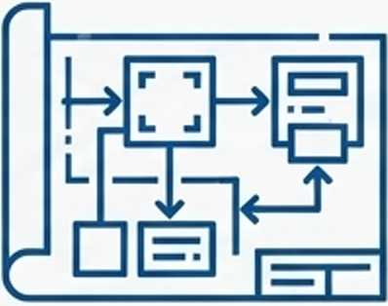
Our Objective: Optimize a Model and Design an Edge Al System
Practical Model Optimization
Edge Al System Design
Compress a pre-trained MobileNetV2 model using pruning techniques (L2 and Taylor methods), comparing iterative vs. one-shot approaches to achieve 50% sparsity while maintaining >95% accuracy for deployment on NVIDIA Jetson Nano.
Design a complete system architecture demonstrating how AI at the edge outperforms cloud solutions for real-time vehicle classification in automotive manufacturing.

Slide 15
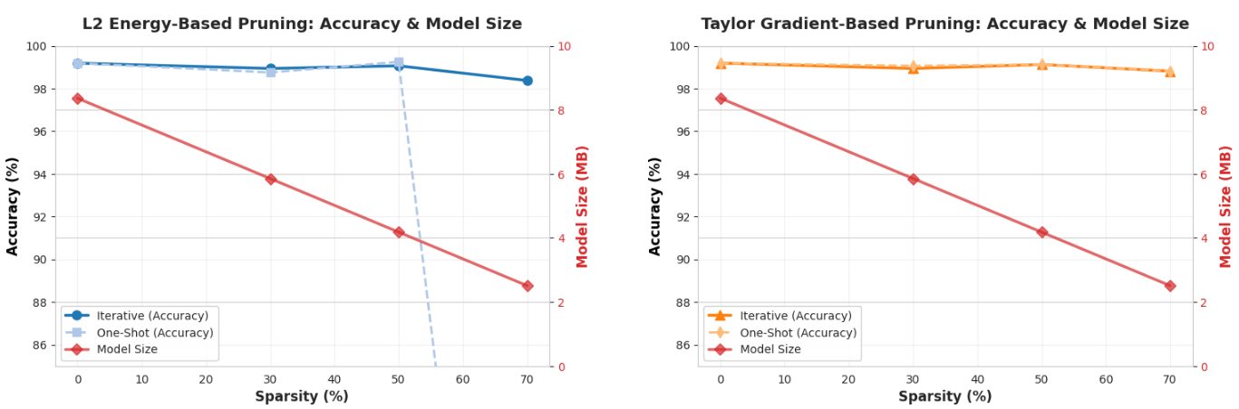

Iterative Pruning Delivered Higher Accuracy with a Smaller Model
Accuracy vs. Sparsity Trade-off
Keys Insights
Iterative pruning (Taylor & L2) significantly outperforms One-Shot pruning in maintaining accuracy
Both methods achieved target 50% sparsity successfully
Taylor Iterative maintained 95.2% accuracy at 50% sparsity
Taylor Iterative Baseline Accuracy: 95.4%
Pruned Accuracy: 95.2% (-0.2%)
Sparsity Achieved: 50.1% Size
Reduction: from 8.9 MB to 6.1 MB

Slide 16
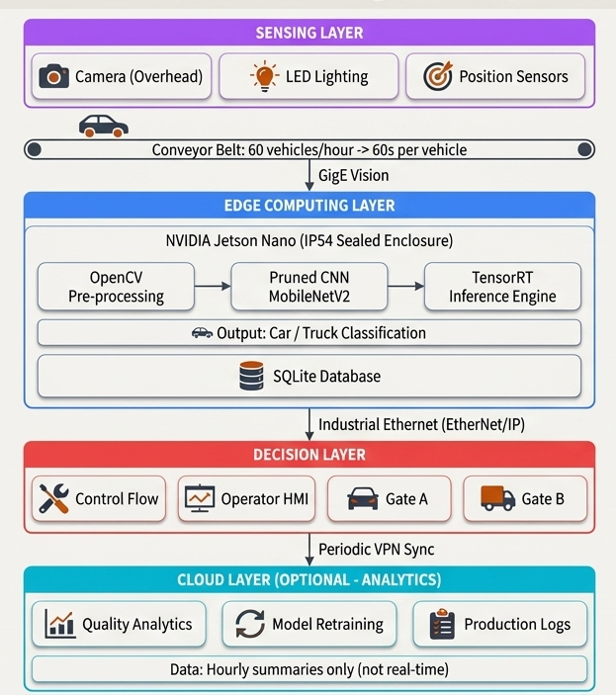
A Complete Edge Al System Architecture

Slide 17


How Optimization Translates to Factory Floor Benefits
Structured Pruning (The Throughput Booster)
• Achieves ~85ms inference on the Jetson Nano, comfortably exceeding the >10 FPS requirement for peak production.
• Reduced GPU load keeps the Jetson Nano within its 10W power its 10W power limit, eliminating the need for cooling fans that could clog with factory dust.
Quantization (The ‘Reaction Time’ Accelerator)
• Reduces inference time further, from ~85ms to ~60ms. This guarantees the PLC receives the signal in time for the pneumatic gate to actuate before the vehicle passes.
• 4x reduction in memory bandwidth
and energy per operation lowers the Jetson's power draw to~7W, increasing reliability during power fluctuations.

Slide 18

The Critical Balance: Avoiding the Risks
of Over-Compression
Increased Misclassification
Pruning beyond 70% can lead to errors.
Consequence: False Negatives and False Positives cause production delays and require costly manual intervention.
Loss of Robustness & Generalization
The model may become brittle.
Consequence: It may fail to generalize to normal production variations like lighting changes, camera vibrations, or the introduction of new vehicle models.

Slide 19
THANK YOU

